Slide 1
TOT
Team of Travellers
The main idea of our project is to provide the tourist-er a new kind of experience to get an over view about the place which he had visited without any tourist guide help using an emerging technology called named RFID-Tags.

Slide 2



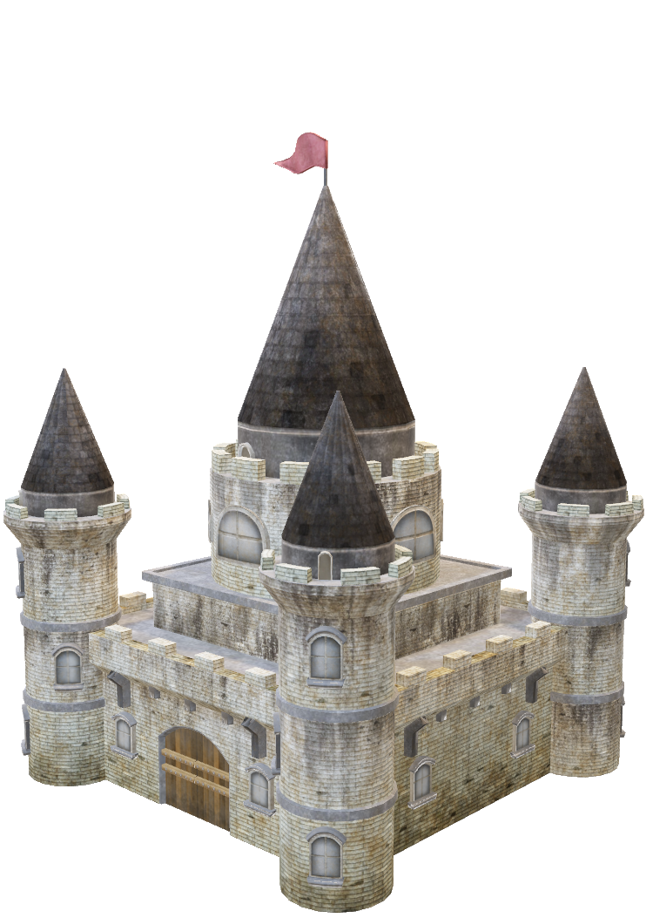

Slide 3
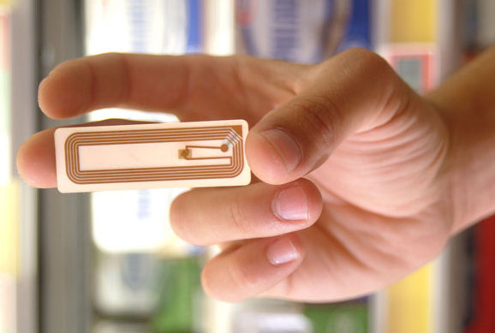
RFID
The emerging RFID technology offers several features and advantages .This technology is undeniably powerful in terms of reliability, efficiency and accuracy. But, have you ever wondered what took RFID so long to become mainstream? Do you have an idea why investors were hesitant at first, before jumping into this modern technology? The simple answer is cost. Yes, the tags are highly expensive, and integrating RFID solutions to millions of items would mean high cost. But, will cost halt this technology from growing? Definitely not.
Before being entangled with the disadvantages, let's focus first on the basic principles of this technology. Together we'll learn the definition of RFID including its functions and components.

Slide 4

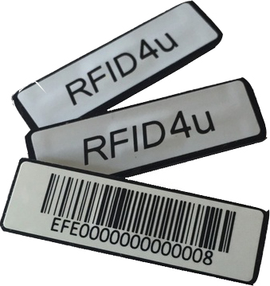

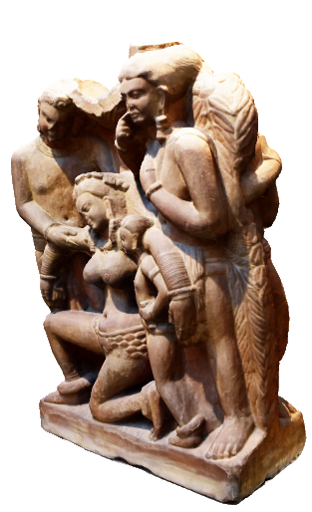


Slide 5
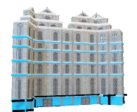


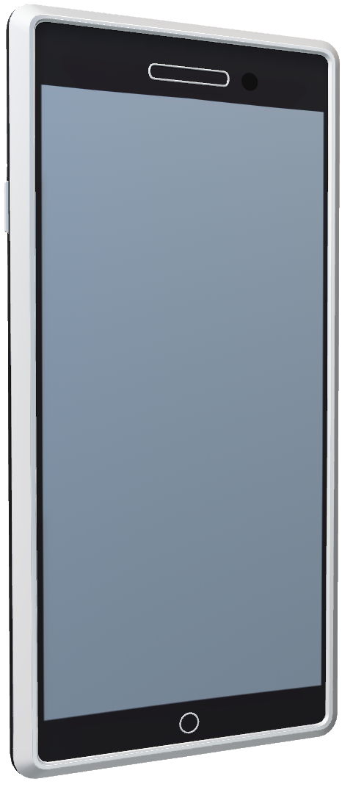
Sculpture
Name:
Crafted by :
Period :
Reason :
Material :
Hospital :
Doctor Details :
Ambulance_No :
Route Map :
Hotel :
Facilities :
Phone No :
Route Map :

Slide 6
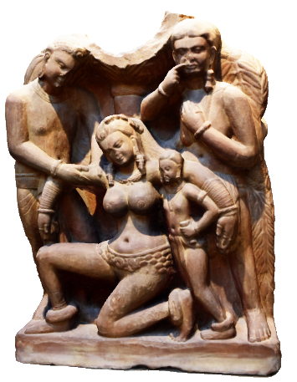
Sculpture Name : Buddhist caves in the Aurangabad
Crafted by : Prevailing's of India
Period : 2nd century BCE
They are under the care of the Archaeological Survey of India and a UNESCO World Heritage Site.

Slide 7
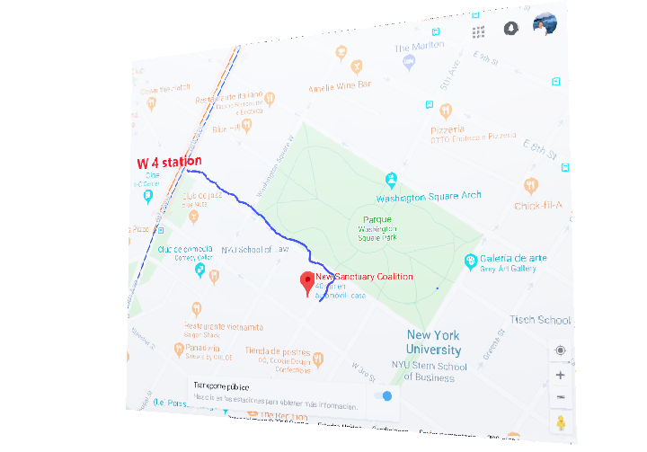
Hospital : JJ Hospitals.
Doctor Details : Dr.Ramasami
Ambulance No : 108
Route Map :

Slide 8
Hotel : Ever green
Facilities : Food, Lodging, Swimming Pool.
Phone Number : 9876543210
Route Map :

Slide 9

